Slide 1


Christian Ackermann
Technische Universität München
Institut für Astronomische und Physikalische Geodäsie

Slide 2
Differences between microcomputer and microcontroller
Microcomputer
CPU
Memory
Interface
Interface
Peripherals

Slide 3
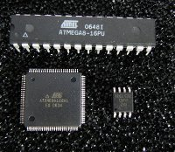
Differences between microcomputer and microcontroller
Microcomputer
Microcomputer
Microcontroller
CPU
Is a semiconductor chip
containing a processor core,
memory and programmable
input/output interfaces
For example some Atmel AVR
microcontrollers:
Memory
Interface
Interface
Peripherals

Slide 4
Communication with the micocontroller
Hardware:
A single MC is not usable. One need a circuit in which the MC is embedded.
This circuit manages the communication between the peripherals and the MC.
E.g. the Arduino microcontroller boards
Software:
To program the MC one need a programming language, a compiler.
Possible languages are:
Assembler
C
Pascal
Basic
Forth
We will use the Arduino development environment. The syntax for the integrated
development environment is C like.

Slide 5
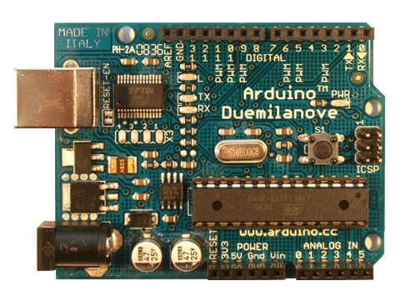
Arduino Duemilanove
Microcontroller ATmega328
Operating Voltage 5V
Input Voltage (recommended) 7-12V
Input Voltage (limits) 6-20V
Digital I/O Pins 14
(of which 6 provide
PWM output)
Analog Input Pins 6
DC Current per I/O Pin 40 mA
DC Current for 3.3V Pin 50 mA
Flash Memory 32 KB (ATmega328)
of which 2 KB
used by bootloader
SRAM 2 KB (Atmega328)
EEPROM 1 KB (ATmega328)
Clock Speed 16 MHz

Slide 6
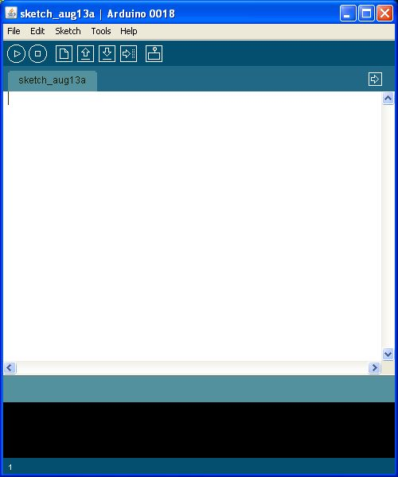
Programming
The Arduino Duemilanove can be
programmed with the Arduino
software.
One can upload new code to the MC
without the use of an external hardware
programmer. It communicates using
the original STK500 protocol.

Slide 7
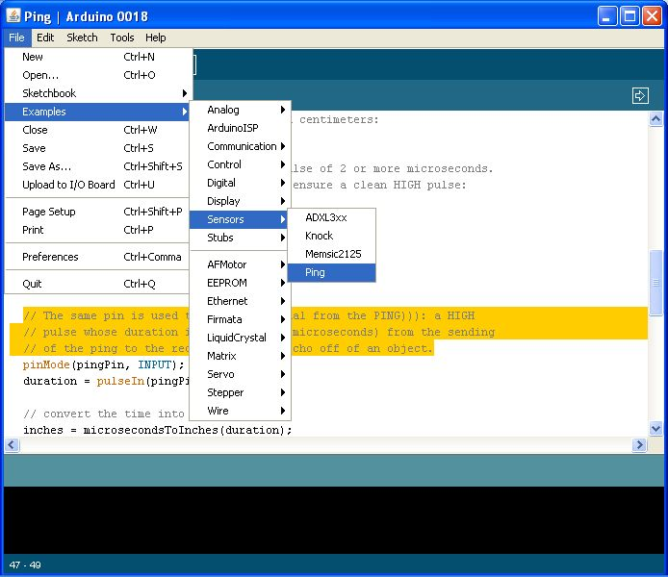
Ping programming

Slide 8
Ping programming
// ping declaration
const int pingPin = 13;
const int DurationInCm = 58;
long duration = 0;
long distance = 0;
// initialize serial communication:
void setup() {
Serial.begin(9600);
}

Slide 9
Ping programming
// ping usage
// The PING))) is triggered by a HIGH pulse of 2 or more microseconds.
// Give a short LOW pulse beforehand to ensure a clean HIGH pulse:
void loop() {
pinMode(pingPin, OUTPUT);
digitalWrite(pingPin, LOW);
delayMicroseconds(2);
digitalWrite(pingPin, HIGH);
delayMicroseconds(10);
digitalWrite(pingPin, LOW);
// The same pin is used to read the signal from the PING))): a HIGH
// pulse whose duration is the time (in microseconds) from the sending
// of the ping to the reception of its echo off of an object.
pinMode(pingPin, INPUT);
duration = pulseIn(pingPin, HIGH);
distance = duration / DurationInCm;
Serial.print(distance);
Serial.println("cm"); }

Slide 10
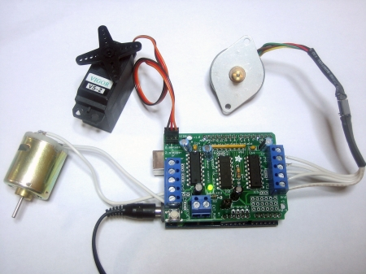
Programming stepper motors
Motor Shield
2 connections for servos
4 bi-directional DC motors
2 stepper motors
http://www.ladyada.net/make/mshield/use.html

Slide 11
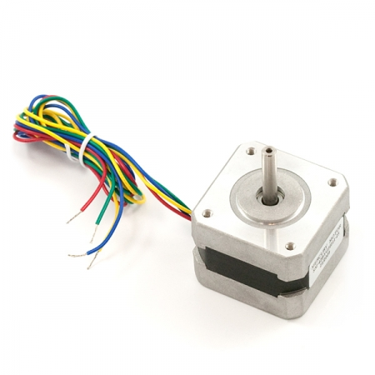
Programming stepper motors
STEP ANGLE | 1.8° (200 Steps/Rev.)
PHASES | 2
VOLTAGE | 12 V
CURRENT | 0.33 A
WEIGHT | 0.20 Kg

Slide 12
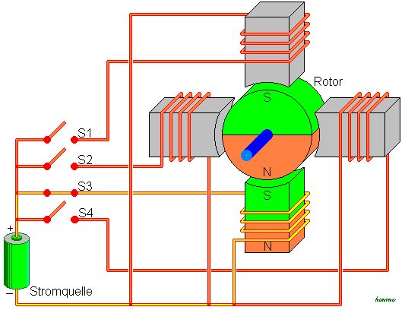
Programming stepper motors

Slide 13
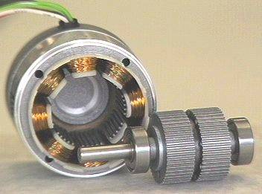
Programming stepper motors

Slide 14
Programming stepper motors

Slide 15
Programming stepper motors
#include <AFMotor.h>
AF_Stepper motor(48, 2); // create a motor object
// 48 are the steps per revolution
// 2 is the port
void setup() {
Serial.begin(9600); // set up Serial library at 9600 bps
Serial.println("Stepper test!");
motor.setSpeed(10); // revolution per minute
motor.step(100, FORWARD, SINGLE); // 100 = how many steps to take
// move FORWARD or BACKWARD
// SINGLE= step type
// also available is DOUBLE, INTERLEAVE
// or MICROSTEP
delay(1000);
}

Slide 16
Programming stepper motors
// example void loop:
void loop() {
motor.step(100, FORWARD, SINGLE);
motor.step(100, BACKWARD, SINGLE);
motor.step(100, FORWARD, DOUBLE);
motor.step(100, BACKWARD, DOUBLE);
motor.step(100, FORWARD, INTERLEAVE);
motor.step(100, BACKWARD, INTERLEAVE);
motor.step(100, FORWARD, MICROSTEP);
motor.step(100, BACKWARD, MICROSTEP);
}

